Slide 1
Automated testing

Slide 2
Automated testing: The management and performance of test activities, to include the development and execution of test scripts having as objective the verification of test requirements, using an automated test tool.

Slide 3
Types of Automated Tests

Slide 4
Automated testing vs. Manual testing
Pros
If a set of tests must be ran repeatedly, automation is a huge win
Offers the possibility to add a large test matrix (e.g. different languages on different OS platforms)
Automated tests can be run the same time on different machines, whereas manual tests must be run sequentially
Cons
Costs - Writing the test cases and writing or configuring the automate framework that is used costs more initially than running the test manually.
Some tests can't be automated – manual tests are needed

Slide 5
Decision to Automate Test: Overcoming False Expectations
EXPECTATION
Automatic test plan generation
Test tool fits all
Imminent test effort reduction
Tool ease of use
Universal application of test automation
100% test coverage
REALITY
No tool can create automatically a comprehensive test plan
No single tool can support all operating systems environments and programming languages
Initial use of an automated test tool can actually increase the test effort
Using an automated tool requires new skills, additional training is required
Not all the tests required for a project can be automated (e.g. some test are physically impossible; time or cost limitation)
It is impossible to perform an exhaustive testing of all the possible inputs (simple or combination) to a system

Slide 6
Most of Today’s Testing is Still Done Manually
What percentage of your test execution is automated?*
More than 80% | 10%
Between 41% and 80% | 12%
Between 20% and 40% | 15%
Less than 20% | 56%
We do not automate | 7%
*From an Enterprise IT Poll in Europe

Slide 7
 | (testing system) | (tested system)
Appium | Windows, Linux, Mac (Python, C#, Ruby, Java, Javascript, PHP, Robot Framework) | iOS, Android (both native App & browser hosted app) | JS Foundation
Blisk | Windows, Mac, Linux | Web | Blisk
eggPlant Functional | Windows, Linux, OS X | Windows, Linux, OS X, iOS, Android, Blackberry, Win Embedded, Win CE | TestPlant Ltd
HP WinRunner | Windows | Windows | Hewlett-Packard
Robot Framework | Web (cross-browser) | Web | (Collaborative project)
Sahi | Web (cross-browser), Windows | Web, Java, Java Web Start, Applet, Flex | Tyto Software[13]
Selenium | Web (cross-browser) | Web | (Collaborative project)
SOAtest | Windows, Linux, (cross-browser) | Web (cross-browser) | Parasoft
Test Studio | Windows | Windows, Test Studio, Android, iOS | Telerik by Progress
TestComplete | Windows | Windows, Android, iOS, Web | SmartBear Software
Testing Anywhere | Un­known | Un­known | Automation Anywhere
TestPartner | Windows | Windows | Micro Focus
Twist | Un­known | Un­known | ThoughtWorks
Unified Functional Testing (UFT)(QTP) | Windows | Windows, Web, Mobile, Terminal Emulators, SAP, Siebel, Java, .NET, Flex, others...[23] | Hewlett-Packard Enterprise

Slide 8
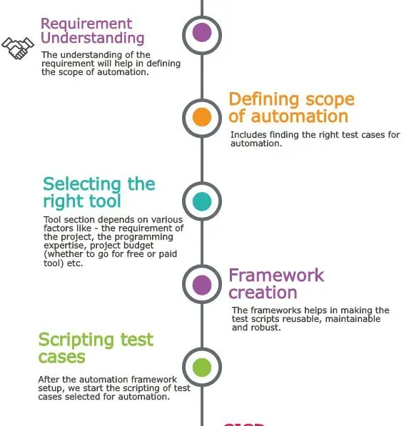

Slide 9
Framework Creation Depend on Tool and Req?

Slide 10
Scripting test cases
A typical script for a web application test case looks like this-
Open browser
Navigate to the application URL
Perform some actions on different web elements
Post some data picked from external test data files
Validation or assertion logic

Slide 11
Selenium

Slide 12
Free and open-source
Web-based applications
Different browsers, platforms, and programming languages

Slide 13
Components of Selenium Suite
Selenium IDE
-- Record and playback automation tool
-- Automate the web applications.
-- Chrome and Firefox browser extension -- People with no or limited programming language experience
2. Selenium RC
-- Selenium Remote Control(RC)
-- Inject the javascript code in the browser for automation
-- Required an additional server for running the automation scripts -- Limitations
Slow
No headless browser

Slide 14
3. Selenium WebDriver
– Most important component
-- Different drivers for different browsers – Chrome, Firefox, IE, Safari, etc
-- Support multiple programming languages– Java, Python, Ruby, etc. --Purely object-oriented
-- Automates the browsers by calling their native method directly unlike Selenium RC which injects javascript in browsers.
Webdriver is much faster than Selenium RC.
-- Directly calls the methods of different browsers
hence we have a separate driver for each browser.
4. Selenium Grid
--Helps in the distributed running of Selenium tests in parallel across multiple remote machines.
-- Has a hub and multiple nodes.
Nodes run the Selenium instances on which the test cases are executed.
Nodes are connected to a central hub
Hub acts as a server and controls the whole test execution.

Slide 15
Advantages
open source, no licensing cost
Scripting --widely used programming languages like Java, C#, Ruby, and Python.
Provides platform support for– Windows, Linux, Mac OS, and Solaris.
Supports --Chrome, Firefox, Edge, Internet Explorer, Opera, and Safari.
Provides record and playback features

Slide 16
Limitations
Does not provide desktop application support
Web Services – REST or SOAP cannot be automated using Selenium.
Selenium WebDriver requires programming language requirements for script creation.

Slide 17
Webdriver Installation

Slide 18
Configuring Java on a machine.
Download the latest version of the Java Development Kit(JDK) from Oracle.com.
Eclipse or any Java IDE
Download the latest version of the Java IDE (Eclipse.org. )
Selenium WebDriver jar
Selenium.dev website and under “Selenium Client & WebDriver Language Bindings”, click on ‘Download’ link for language Java.
Unzip and place it on any directory as a library folder (Remember the name)
Creating a project and configuring Selenium jars.

Slide 19
Creating a project and configuring Selenium jars
Launch eclipse.exe.
Set your workspace to any location
Create a new project- File->New->Project…->Java->Java Project (Remember Name) click Finish.
Under src folder
Create a package-Right Click src->New->Package. Name your package
Inside this package create a new class and name it.
Right Click your project on the left
Click on properties
Click on “Java Build Path” on the left
Click on the Libraries tab on the right
Click on the “Add External Jars..” button.
browse to the location where selenium libraries are placed
Addlibraries-selenium-java-2.39.0.jar and selenium-java-2.39.0-srcs.jar
libraries present in the libs folder

